Slide 1

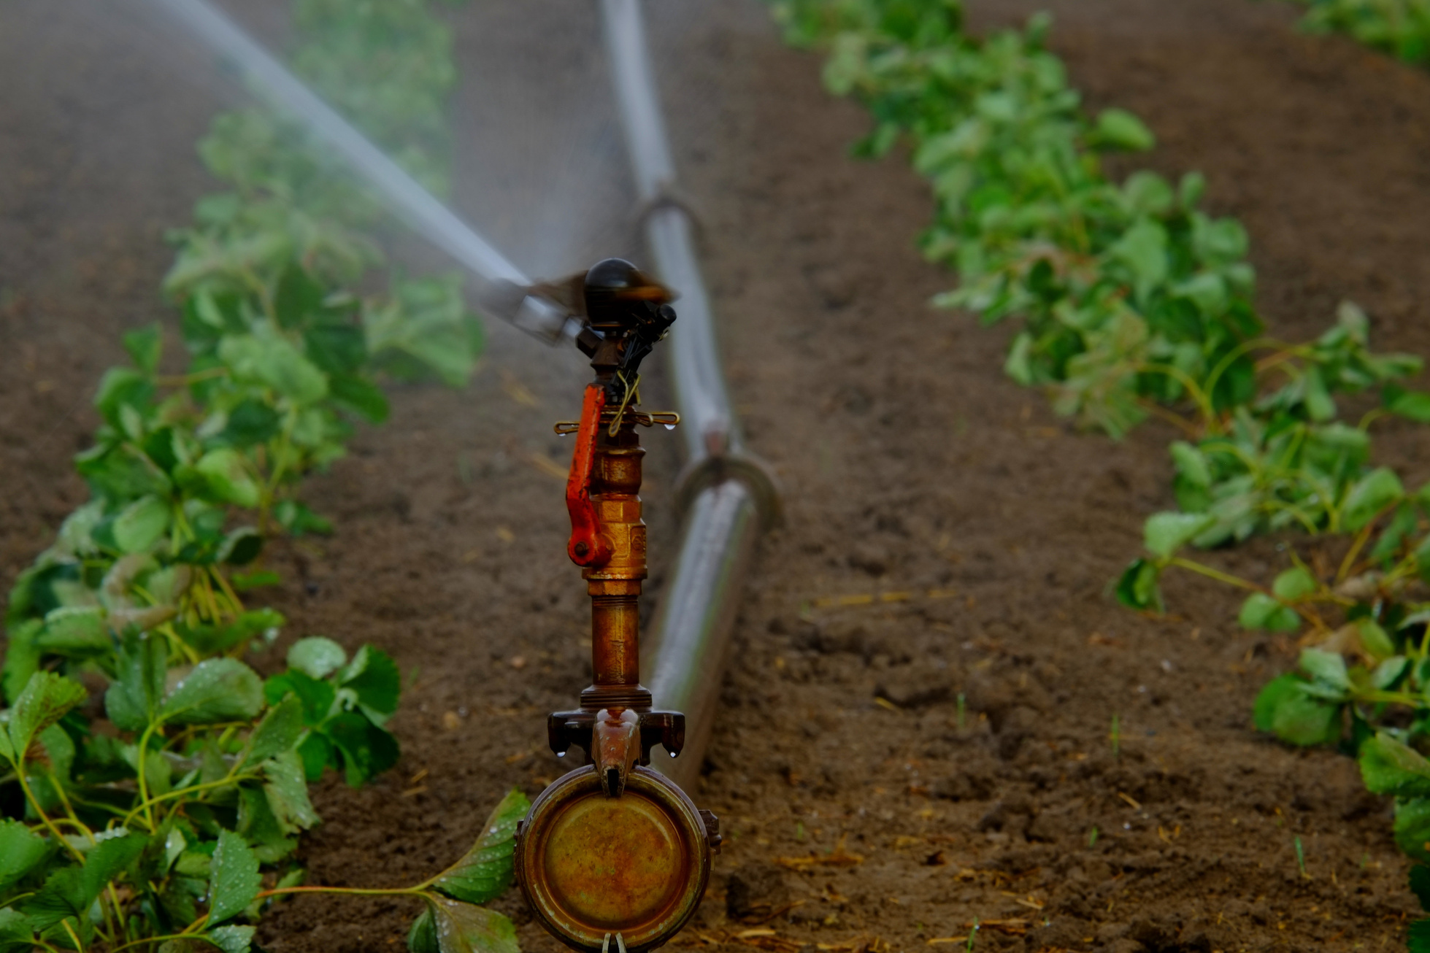

Smart Irrigation Control in
Commercial
Greenhouse Facilities
“This isn’t just automation; it’s agricultural intelligence."
Sensitivity: LNT Construction Internal Use

Slide 2


Content
1. Introduction
2. Problem Overview
3. Problem Statement
4. Goal and Objectives
5. Proposed Solution
6. Resources Utilized
7. System Design
Block Diagram
Architectural Diagram
8. Implementation Details
9. Results & Observations
10. Advantages & Limitations
11. Future Scope
12. Conclusion
Sensitivity: LNT Construction Internal Use

Slide 3
Project Overview
Brief Introduction to the project
Efficient irrigation is essential in commercial greenhouses to ensure high crop yield and resource sustainability. This project introduces a smart, sensor-driven irrigation system that adapts dynamically to environmental conditions, enhancing productivity and efficiency.
Domain relevance
This project lies at the intersection of Agriculture, IoT (Internet of Things), and Embedded Systems with Machine Learning. It addresses the pressing need for sustainable agricultural practices by introducing automation and intelligence into irrigation control.
Sensitivity: LNT Construction Internal Use

Slide 4
Project Overview
Purpose of combining Embedded Systems with ML
Real-time Monitoring & Automation: Uses sensors, microcontrollers, and cloud platforms to track soil and environmental data, predict irrigation needs, and automate water delivery.
Improved Efficiency & Crop Health: Ensures optimal water usage and stable soil conditions, boosting both water efficiency and crop growth.
ML adds the capability of learning from historical data, forecasting water requirements, and optimizing schedules beyond rule-based automation.
Sensitivity: LNT Construction Internal Use

Slide 5
Problem Statement
Sensors: Soil Moisture (1), DS18B20(1)
Problem Description:
Water efficiency in greenhouses boosts yield and sustainability. Soil Moisture and DHT11 sensors provide real-time soil and climate data. Cloud-based ML models analyze this data to adjust irrigation schedules. Data analytics tools offer moisture trend visualization, water consumption forecasting, and optimal scheduling insights. This results in smart irrigation and better crop outcomes.
Sensitivity: LNT Construction Internal Use

Slide 6
What Real-World Problem Are You Solving?
This project addresses the challenge of inefficient water use in commercial greenhouses due to static, manual irrigation systems.
These systems fail to adapt to real-time environmental conditions, often leading to overwatering or underwatering, which affects plant health, wastes water, and increases operational costs.
Why Is It Important?
Water is a critical and limited resource, especially in agriculture. Efficient irrigation directly impacts crop yield, resource sustainability, and operational efficiency.
By using smart irrigation based on real-time data and ML-driven insights, this project promotes sustainable farming practices, reduces water wastage, and improves agricultural productivity in controlled environments like greenhouses.
Sensitivity: LNT Construction Internal Use

Slide 7
Project Goal & Objectives
Project Goal:
To develop an intelligent irrigation control system for commercial greenhouses that optimizes water usage by leveraging real-time environmental data and machine learning-based decision-making.
Measurable Objectives:
Real-time Monitoring: Continuously track soil moisture and temperature using embedded sensors.
Automated Control: Trigger irrigation automatically based on sensor thresholds.
ML-Based Optimization: Use cloud-based ML to forecast and refine irrigation schedules.
Water Efficiency: Reduce water usage compared to conventional irrigation systems.
Sensitivity: LNT Construction Internal Use

Slide 8
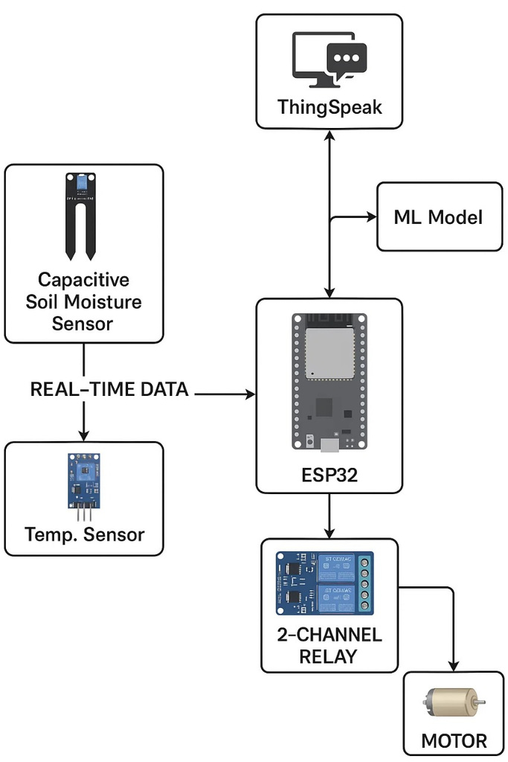
Proposed Solution
System Architecture diagram
Sensitivity: LNT Construction Internal Use

Slide 9
Proposed Solution
1. Data Collection
Embedded devices like ESP32 gather real-time data (e.g., soil moisture, temperature).
These values are streamed continuously from sensors to a microcontroller.
The system pre-processes this data (filtering, averaging) before passing it forward.
2. Communication to the Cloud
Using Wi-Fi the data is pushed to cloud platforms (ThingSpeak).
Here, vast datasets are stored, enabling long-term analysis.
3. Machine Learning Models
ML models are trained using historical sensor data.
Models can predict:
Future soil moisture trends.
When irrigation is needed.
Sensitivity: LNT Construction Internal Use

Slide 10
Resources Utilized
Resources Utilized
Hardware:
ESP32 Microcontroller
Soil Moisture Sensor
DS18B20 Temperature Sensor
5V Relay Module
Mini Water Pump (controlled via relay)
Power Supply Module
Software & Tools:
Arduino IDE (code development and upload)
ThingSpeak (cloud data logging and visualization)
Python (for ML model development and integration)
Power BI
Sensitivity: LNT Construction Internal Use

Slide 11
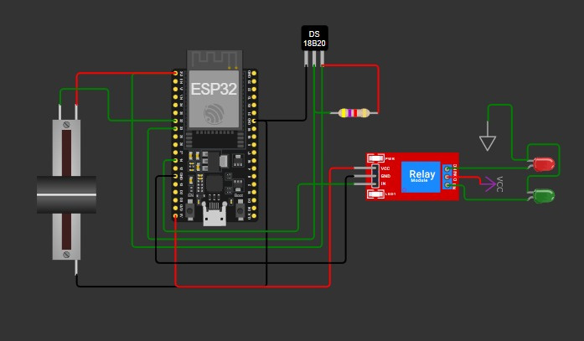
Circuit Diagram
Sensitivity: LNT Construction Internal Use

Slide 12
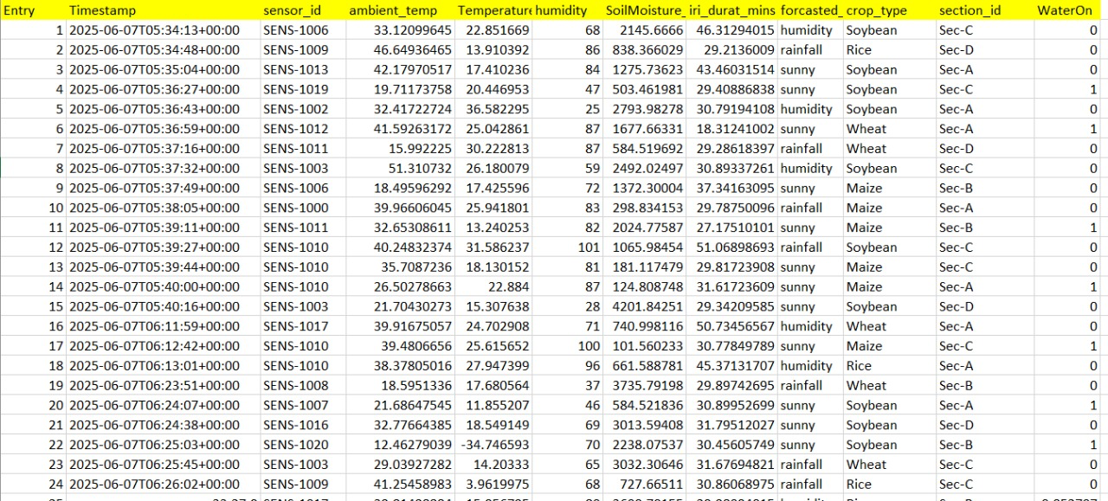
Resources Utilized
Datasets/ML Model used
Sensitivity: LNT Construction Internal Use

Slide 13
Implementation Details
🟩 Day 1: Design Thinking & Problem Framing
Started with identifying a real-world issue: monitoring and controlling water quality efficiently.
Applied the Design Thinking process: Empathize, Define, Ideate, Prototype Plan, Test Strategy
🟨 Day 2: Wokwi Simulation & Embedded Coding
Created 3 simulation stages in Wokwi:
Basic sensor setup for reading values.
Sensor readings displayed on OLED screen.
Integration of CO₂ sensor with cloud connectivity via ThingSpeak.
Wrote and tested code in Embedded C, validating output for each module.
Sensitivity: LNT Construction Internal Use

Slide 14
Implementation Details
🟧 Day 3: Hardware Implementation & ML Dataset Creation
Assembled hardware setup with ESP32 and all sensors.
Took real-time sensor readings to build a custom dataset.
Trained an XGBoost machine learning model to analyze and predict water quality.
Ensured smooth data flow from sensors to cloud and into the model.
🟥 Day 4: Model Comparison & Dashboard Integration
Compared different ML models (e.g., Decision Tree, XGBoost, Random Forest) for accuracy.
Integrated prediction results into Power BI for visualization.
Built an interactive dashboard to display real-time trends, sensor data, and ML outputs.
Sensitivity: LNT Construction Internal Use

Slide 15

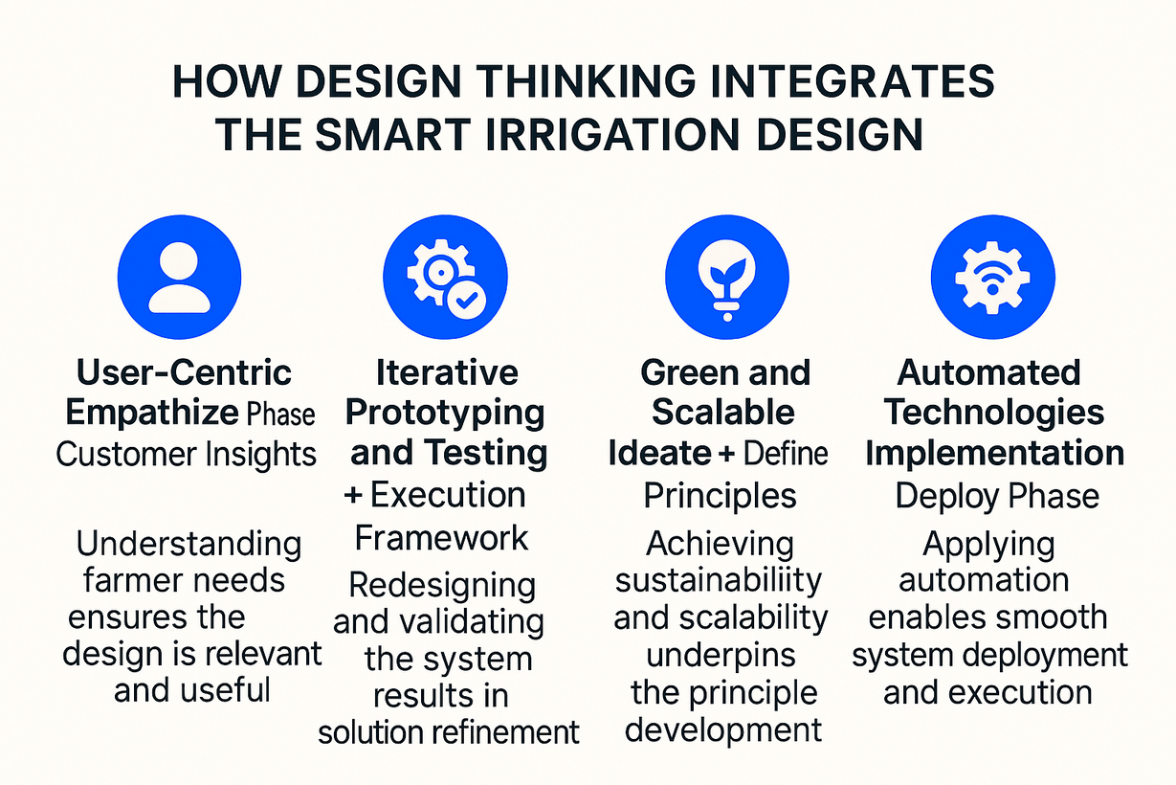
DESIGN THINKING
Sensitivity: LNT Construction Internal Use

Slide 16
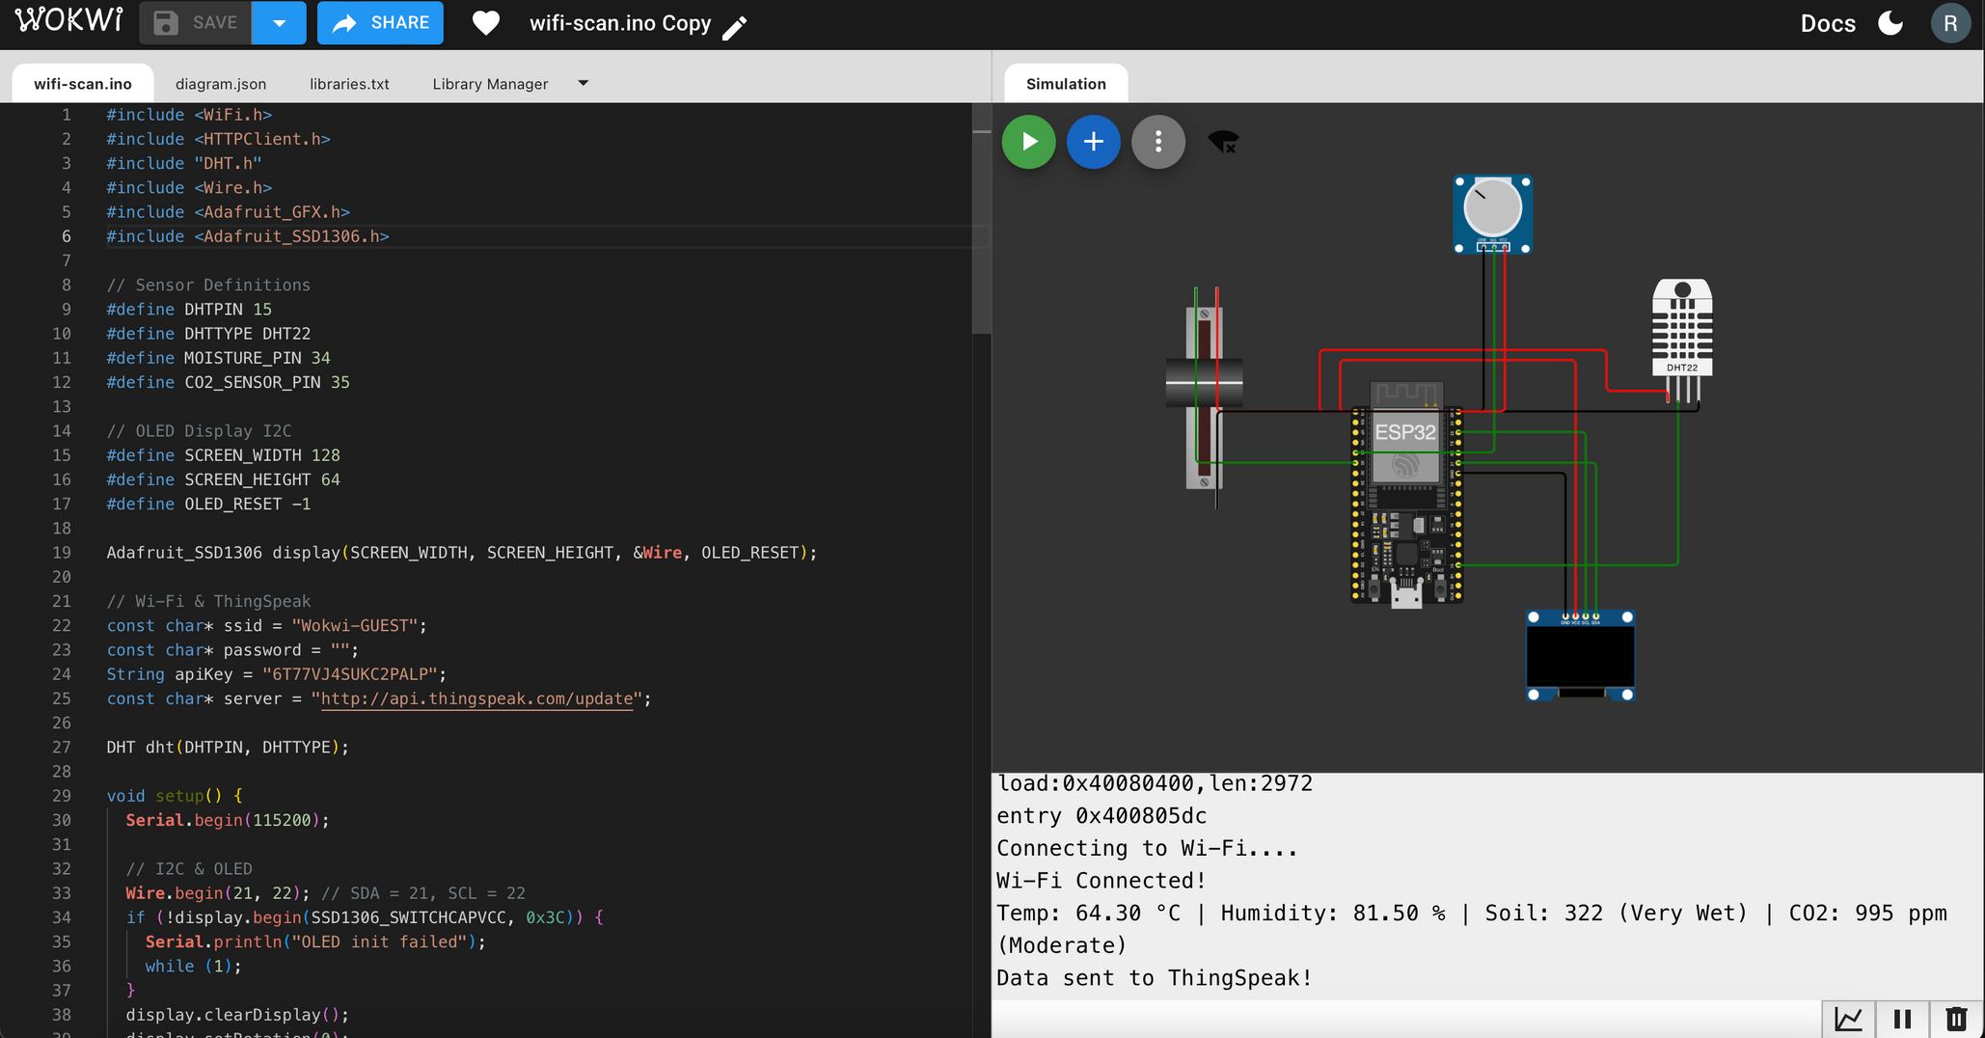
DESIGN THINKING
Sensitivity: LNT Construction Internal Use

Slide 17
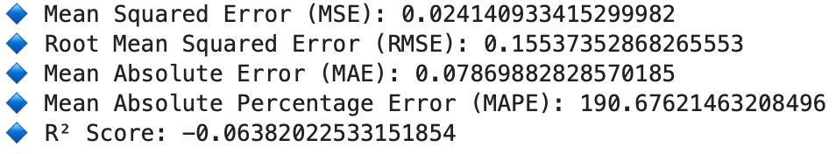
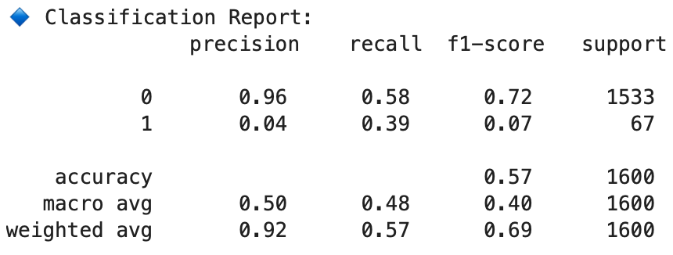
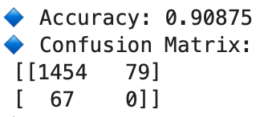
Results & Observations
Accuracy of the model
Sensitivity: LNT Construction Internal Use

Slide 18
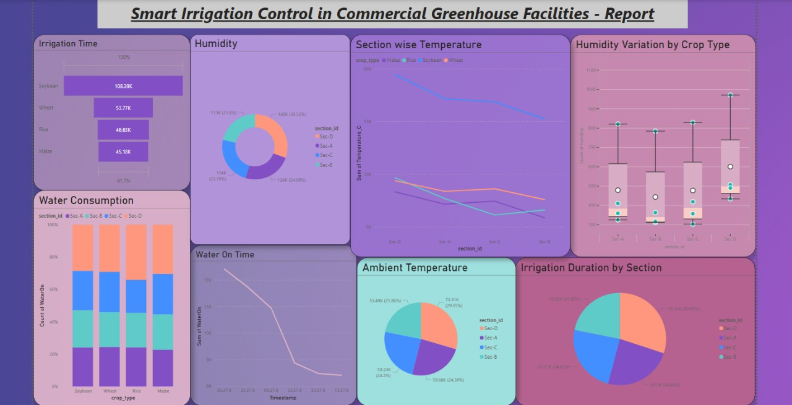
Sensitivity: LNT Construction Internal Use

Slide 19
Advantages & Limitations
✅ Advantages
Ensures efficient water usage by irrigating only when needed.
Enhances crop yield through optimal soil moisture management.
Allows remote monitoring and control using IoT technology.
⚠️ Limitations
High initial setup cost due to sensors and controllers.
System relies on continuous internet and power availability.
Sensors require periodic maintenance and calibration.
🚧 Constraints
Components must be compatible with ESP32 and each other.
System must operate reliably in humid greenhouse conditions.
Water pump and flow must match the system’s requirements.
Sensitivity: LNT Construction Internal Use

Slide 20
Future Scope
Project Scalability
Sensor Expansion: Add turbidity, DO, nitrate sensors for broader applications.
Edge AI: Deploy on-device ML for real-time predictions without cloud dependency.
Solar Power: Enable remote, off-grid operation with renewable energy.
Dashboard Upgrade: GIS maps and analytics for multi-site monitoring.
IoT Integration: Compatible with smart agriculture and urban systems.
Deployment Possibilities
Smart Irrigation: Automated watering based on water quality.
Urban Water Monitoring: Ensure safe water in public supplies.
Industrial Use: Monitor wastewater for compliance.
Home Systems: Alert-based filtration monitoring
Sensitivity: LNT Construction Internal Use

Slide 21
Conclusion
Summary of Learnings
Gained hands-on experience in integrating sensors (pH, TDS, temperature) with ESP32.
Understood cloud communication via ThingSpeak and real-time data handling.
Learned how machine learning can enhance decision-making in embedded systems.
Explored the role of automation in efficient water resource management.
Key Achievements
Successfully built a functional prototype for water quality monitoring.
Enabled real-time data visualization and control via IoT and ML integration.
Designed a scalable system with potential for real-world deployment.
Promoted sustainable practices through smart water usage.
Sensitivity: LNT Construction Internal Use

Slide 22
Thank you
Sensitivity: LNT Construction Internal Use
Notes:
14

